Slide 1
GSM

Slide 2
Global System for Mobile Communications
Originally GSM stood for Groupe Speciale Mobile
GSM to meet the following business objectives
Support for international roaming
Good speech quality
Ability to support handheld terminals
Low terminal and service cost
Spectral efficiency
Support for a range of new services and facilities
ISDN compatibility

Slide 3
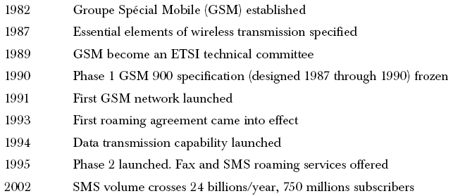
GSM Timeline

Slide 4
Use of TDMA and FDMA in GSM
Uses a combination of FDMA (Frequency Division Multiple Access) and TDMA (Time Division Multiple Access)
Allocation of 50 MHz (890–915 MHz and 935–960 MHz) bandwidth in the 900 MHz frequency band and using FDMA further divided into 124 (125 channels, 1 not used) channels each with a carrier bandwidth of 200 KHz
Using TDMA, each of the above mentioned channels is then further divided into 8 time slots
So, with the combination of FDMA and TDMA, a maximum of992 channels for transmit and receive can be realized

Slide 5
Frequency reuse in GSM
To serve hundreds of thousands of users, the frequency must be reused and this is done through cells.
The area to be covered is subdivided into radio zones or cells. Though in reality these cells could be of any shape, for convenient modeling purposes these are modeled as hexagons. Base stations are positioned at the center of these cells.
Each cell i receives a subset of frequencies fbi from the total set assigned to the respective mobile network. To avoid any type of co-channel interference, two neighboring cells never use the same frequencies.

Slide 6
Frequency reuse in GSM
Only at a distance of D (known as frequency reuse distance), the same frequency from the set fbi can be reused. Cells with distance D from cell i, can be assigned one or all the frequencies from the set fbi belonging to cell i.
When moving from one cell to another during an ongoing conversation, an automatic channel change occurs. This phenomenon is called handover. Handover maintains an active speech and data connection over cell boundaries.
The regular repetition of frequencies in cells result in a clustering of cells. The clusters generated in this way can consume the whole frequency band. The size of a cluster is defined by k, the number of cells in the cluster. This also defines the frequency reuse distance D. The figure in next slide shows an example of cluster size of 4.

Slide 7
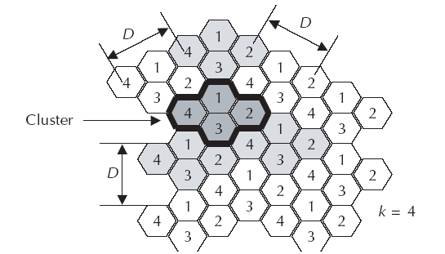
Cell clusters in GSM

Slide 8
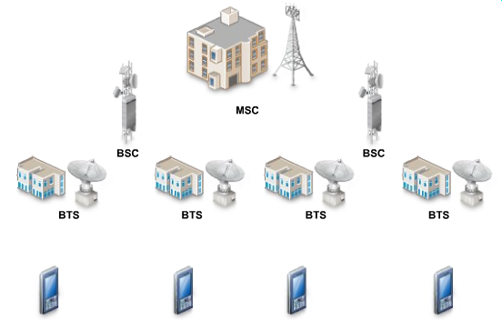
Cellular network components

Slide 9
Cellular network components (2)
BTS (Base Transceiver Station) – main component of a cell and it connects the subscribers to the cellular network; for transmission/reception of information it uses several antennas spread across the cell
BSC (Base Station Controller) – it is an interface between BTSs and it is linked to BTSs by cable or microwave links; it routes calls between BTSs; it is also connected to the MSC
MSC (Mobile Switching Center) – the coordinator of a cellular network, it is connected to several BSCs, it routes calls between BSCs; links the cellular network with other networks like PSTN through fiber optics, microwave or copper cable

Slide 10
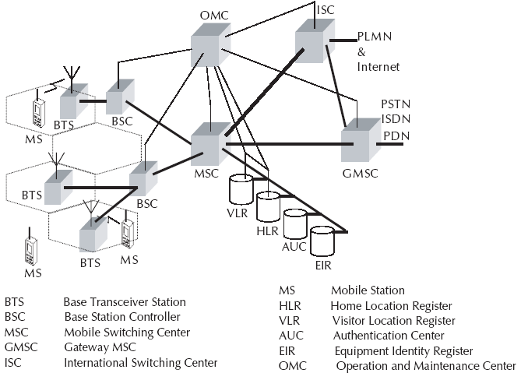
GSM Architecture

Slide 11
GSM Architecture
Cells are formed by the radio areas covered by a BTS (Base Transceiver Station)
Several BTSs are controlled by one BSC
Traffic from the MS (Mobile Station) is routed through MSC
Calls originating from or terminating in a fixed network or other mobile networks is handled by the GMSC (Gateway MSC)

Slide 12






Components of a cellular phone (MSU – Mobile Subscriber Unit)
radio transceiver – low power radio transmitter and receiver
antenna, usually located inside the phone
control circuitry – formats the data sent to and from the BTS; controls signal transmission and reception
man-machine interface – consists from a keypad and a display; is managed by the control circuitry
Subscriber Identity Module (SIM) – integrated circuit card that stores the identity information of subscriber
battery, usually Li-ion, the power unit of the phone

Slide 13
Subscriber Identity Module (SIM) card
SIM – a memory card (integrated circuit) holding identity information, phone book etc.
GSM system support SIM cards
other systems, like CDMA do not support SIM cards, but have something similar called Re-Usable Identification Module (RUIM)

Slide 14
International Mobile Equipment Identity (IMEI) key
IMEI – a unique 15 digit number identifying each phone, is incorporated in the cellular phone by the manufacturer
IMEI ex.: 994456245689001
when a phone tries to access a network, the service provider verifies its IMEI with a database of stolen phone numbers; if it is found in the database, the service provider denies the connection
the IMEI is located on a white sticker/label under the battery, but it can also be displayed by typing *#06# on the phone

Slide 15
International Mobile Subscriber Identity (IMSI) key
IMSI – a 15-digit unique number provided by the service provider and incorporated in the SIM card which identifies the subscriber
IMSI enables a service provider to link a phone number with a subscriber
first 3 digits of the IMSI are the country code

Slide 16
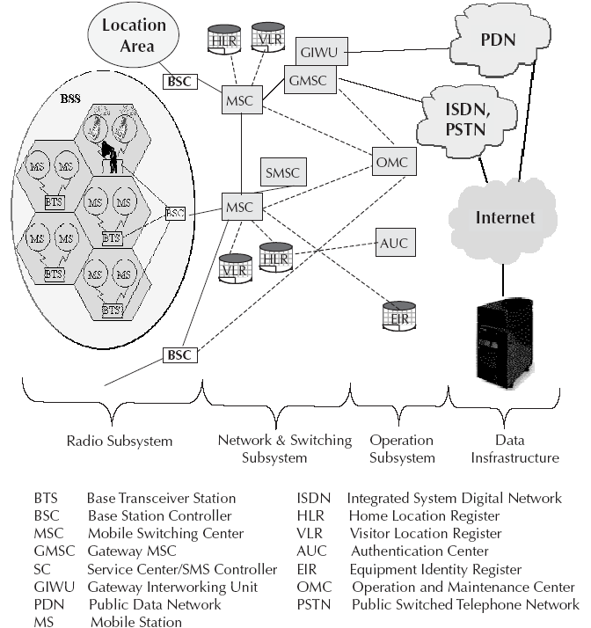
Operational Architecture of GSM

Slide 17
Setting up a call process
when powered on, the phone does not have a frequency/ time slot assigned to it yet; so it scans for the control channel of the BTS and picks the strongest signal
then it sends a message (including its identification number) to the BTS to indicate its presence
the BTS sends an acknowledgement message back to the cell phone
the phone then registers with the BTS and informs the BTS of its exact location
after the phone is registered to the BTS, the BTS assigns a channel to the phone and the phone is ready to receive or make calls

Slide 18
Making a call process
the subscriber dials the receiver’s number and sends it to the BTS
the BTS sends to its BSC the ID, location and number of the caller and also the number of the receiver
the BSC forwards this information to its MSC
the MSC routes the call to the receiver’s MSC which is then sent to the receiver’s BSC and then to its BTS
the communication with the receiver’s cell phone is established

Slide 19
Receiving a call process
when the receiver’ phone is in an idle state it listens for the control channel of its BTS
if there is an incoming call the BSC and BTS sends a message to the cells in the area where the receiver’s phone is located
the phone monitors its message and compares the number from the message with its own
if the numbers matches the cell phone sends an acknowledgement to the BTS
after authentication, the communication is established between the caller and the receiver

Slide 20
HLR, VLR and EIR registers
Home Location Register (HLR) - is a database maintained by the service provider containing permanent data about each subscriber (i.e. location, activity status, account status, call forwarding preference, caller identification preference)
Visitor Location Register (VLR) – database that stores temporary data about a subscriber; it is kept in the MSC of the of the area the subscriber is located in; when the subscriber moves to a new area the new MSC requests this VLR from the HLR of the old MSC
Equipment Identity Register (EIR) – database located near the MSC and containing information identifying cell phones

Slide 21
Home Location Register (HLR) in GSM
It contains the following information:
Authentication information like International Mobile Subscriber Identity (IMSI)
Identification information like name, address, etc. of the subscriber
Identification information like Mobile Subscriber ISDN (MSISDN) etc.
Billing information like prepaid or postpaid
Operator selected denial of service to a subscriber

Slide 22
Home Location Register (HLR) in GSM
Handling of supplementary services like for CFU (Call Forwarding Unconditional), CFB (Call Forwarding Busy), CFNR (Call Forwarding Not Reachable) or CFNA (Call Forwarding Not Answered)
Storage of SMS Service Center (SC) number in case the mobile is not connectable so that whenever the mobile is connectable, a paging signal is sent to the SC
Provisioning information like whether long distance and international calls allowed or not
Provisioning information like whether roaming is enabled or not

Slide 23
Home Location Register (HLR) in GSM
Information related to auxiliary services like Voice mail, data, fax services, etc.
Information related to auxiliary services like CLI (Caller Line Identification), etc.
Information related to supplementary services for call routing. In GSM network, one can customize the personal profile to the extent that while the subscriber is roaming in a foreign PLMN, incoming calls can be barred. Also, outgoing international calls can be barred, etc.
Some variable information like pointer to the VLR, location area of the subscriber, Power OFF status of the handset, etc.

Slide 24
Entities in GSM
The Mobile Station (MS) - This includes the Mobile Equipment (ME) and the Subscriber Identity Module (SIM).
The Base Station Subsystem (BSS) - This includes the Base Transceiver Station (BTS) and the Base Station Controller (BSC).
The Network and Switching Subsystem (NSS) - This includes Mobile Switching Center (MSC), Home Location Register (HLR), Visitor Location Register (VLR), Equipment Identity Register (EIR), and the Authentication Center (AUC).
The Operation and Support Subsystem (OSS) - This includes the Operation and Maintenance Center (OMC).

Slide 25
Mobile Station
Mobile Station (MS) consists of two main elements: mobile equipment or mobile device (that is the phone without the SIM card) and Subscriber Identity Module (SIM)
Terminals distinguished principally by their power and application
SIM is installed in every GSM phone and identifies the terminal
SIM cards used in GSM phones are smart processor cards with a processor and a small memory
SIM card contains the International Mobile Subscriber Identity (IMSI) used to identify the subscriber to the system, a secret key for authentication, and other security information

Slide 26
Base Station Subsystem
Base Station Subsystem (BSS) connects the Mobile Station and the Network and Switching Subsystem (NSS)
In charge of the transmission and reception for the last mile
BSS can be divided into two parts: Base Transceiver Station (BTS) or Base Station and Base Station Controller (BSC)
Base Transceiver Station corresponds to the transceivers and antennas used in each cell of the network
BTS is usually placed in the center of a cell and its transmitting power defines the size of a cell

Slide 27
Base Station Subsystem
BTS houses the radio transmitter and the receivers that define a cell and handles the radio-link protocols with the Mobile Station
Each BTS has between one and sixteen transceivers depending on the density of users in the cell
Base Station Controller is the connection between the BTS and the Mobile service Switching Center (MSC) and manages the radio resources for one or more BTSs
BSC handles handovers, radio-channel setup, control of radio frequency power levels of the BTSs, exchange function, and the frequency hopping

Slide 28
Network and Switching Subsystem
Central component of the Network Subsystem is the Mobile Switching Center (MSC)
Signaling between functional entities in the Network Subsystem uses Signaling System Number 7 (SS7)
MSC does the following functions:
It acts like a normal switching node for mobile subscribers of the same network (connection between mobile phone to mobile phone within the same network)

Slide 29
Network and Switching Subsystem
It acts like a normal switching node for the PSTN fixed telephone (connection between mobile phone to fixed phone)
It acts like a normal switching node for ISDN
It provides all the functionality needed to handle a mobile subscriber, such as registration, authentication, location updating, handovers and call routing
It includes databases needed in order to store information to manage the mobility of a roaming subscriber

Slide 30
Network Switching Subsystem
MSC together with Home Location Register (HLR) and Visitor Location Register (VLR) databases, provide the call-routing and roaming capabilities of GSM
HLR contains all the administrative information of each subscriber registered in the corresponding GSM network
Location of the mobile is typically in the form of the signaling address of the VLR associated with the mobile station
HLR is always fixed and stored in the home network, whereas the VLR logically moves with the subscriber
VLR is similar to a cache, whereas HLR is the persistent storage

Slide 31
Network and Switching Subsystem
VLR contains selected administrative information borrowed from the HLR, necessary for call control and provisioning of the subscribed services
When a subscriber enters the covering area of a new MSC, the VLR associated with this MSC can request information about the new subscriber from its corresponding HLR in the home network
There is a component called Gateway MSC (GMSC) that is associated with the MSC

Slide 32
Network and Switching Subsystem
GMSC is the interface between the mobile cellular network and the PSTN and also is in charge of routing calls from the fixed network towards a GSM user and vice versa
GMSC is often implemented in the same node as the MSC

Slide 33
Operation and Support Subsystem
Operations and Support Subsystem (OSS) controls and monitors the GSM system
OSS is connected to the different components of the NSS and to the BSC and also in charge of controlling the traffic load of the BSS
Equipment Identity Register (EIR) rests with OSS
EIR is a database that contains a list of all valid mobile equipment within the network, where each mobile station is identified by its International Mobile Equipment Identity (IMEI)
EIR contains a list of IMEIs of all valid terminals

Slide 34
Operation and Support Subsystem
An IMEI is marked as invalid if it has been reported stolen or is not type approved
The EIR allows the MSC to forbid calls from this stolen or unauthorized terminals
Authentication Center (AUC) is responsible for the authentication of a subscriber
AUC is a protected database and stores a copy of the secret key stored in each subscriber’s SIM card

Slide 35
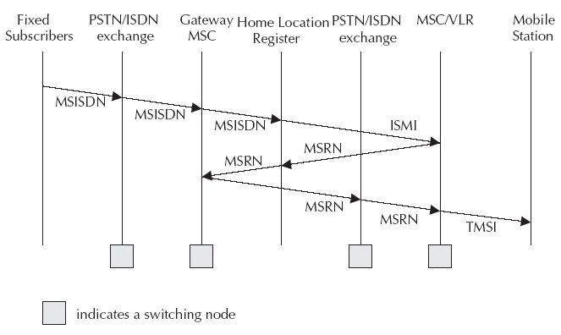
Call Routing

Slide 36
GSM Addresses and Identifiers
International Mobile Station Equipment Identity (IMEI)
International Mobile Subscriber Identity (IMSI)

Slide 37
GSM Addresses and Identifiers
Location Area Identity: Each LA in a PLMN has its own identifier called Location Area Identifier (LAI) which is structured hierarchically and unique. LAI consists of 3 digits of CC, 2 digits of Mobile Network Code and maximum of 5 digits of Location Area Code.
Mobile Station Roaming Number (MSRN): When a subscriber is roaming in another network, a temporary ISDN number is assigned to the subscriber called MSRN. MSRN is assigned by the local VLR in charge of the mobile station and follows the structure of MSISDN.

Slide 38
GSM Addresses and Identifiers
Temporary Mobile Subscriber Identity (TMSI): TMSI is a temporary identifier assigned by the serving VLR used in place of the IMSI for identification and addressing of the mobile station. Together with the current location area, a TMSI allows a subscriber to be identified uniquely.
Local Mobile Subscriber Identity (LMSI): LMSI is assigned by the VLR and stored in the HLR and is used as a searching key for faster database access within the VLR.
Cell Identifier: Within a LA, every cell has a unique Cell Identifier (CI) and together with a LAI, a cell can be identified uniquely through Global Cell Identity (LAI & CI).
MSCs and Location Registers (HLR & VLR) are addressed with ISDN numbers while they may use a Signaling Point Code (SPC) within a PLMN.

Slide 39
Mobility Management
Mobility Management (MM) function handles the procedures that arise from the mobility of the subscriber.
Paging
Location Update
Handover
Roaming

Slide 40
Paging
The MS needs to be traced, located and then the call connected
Tracing through Paging process
A paging message is sent that includes the IMSI as the identifier of the MS
Where to start paging from? Challenge
Paging start at the location where the MS was present last

Slide 41
Location Update
Procedures that enable the network to know the current location of a MS
Location update can be initiated by either MS or the network
IMSI attach procedure where the MS indicates its IMSI to the network
When a mobile station is powered off, it performs an IMSI detach procedure in order to tell the network that it is no longer connected.

Slide 42
Location Update
A location update message is sent to the new MSC/VLR which records the location area information and then sends the location information to the subscriber’s HLR.
If the mobile station is authenticated and authorized in the new MSC/VLR, the subscriber’s HLR cancels the registration of the mobile station with the old MSC/VLR.
Location update is also performed on restricted conditions

Slide 43
Mobility Management
When there is an incoming call for a subscriber, the mobile phone needs to be located and a channel needs to be allocated and the call connected.
A powered-on mobile is informed of an incoming call by a paging message sent over the paging channel of the cells within the current location area while location updating procedures and subsequent call routing use MSC, HLR and VLR.
If the subscriber is entitled to service, HLR sends a subset of the subscriber information needed for call control to the new MSC/VLR and sends a message to the old MSC/VLR to cancel the old registration.

Slide 44
Steps in Hand off/Hand over
Currently Serving BSS requests a Handover_required message to MSC.
MSC sends a Handover_request message to the new BSS.
The new BSS chooses an idle radio resource and send
Handover-request_ack
Handover Command
Radio_interface_handover command

Slide 45
Steps in Hand off/Hand over
4. MS changes its access with a Handover_Access containing the handover reference number
5. BSS checks the reference number and Handover_complete message is sent to MSC
6. MSC will terminate the procedure with old BSS by sending Clear_Command
7. Old BSS will send a Clear_Complete to the MSC

Slide 46
Hand off and Roaming - Difference
Hand off – Moving from one point of attachment to another point of attachment within the same network operator
Movement happens between two different networks it is called roaming.

Slide 47
Roaming
When the subscriber moves to a different operator’s PLMN, the subscriber must register with the new network to indicate its current location.
IMSI Attach – MS indicates its IMSI to the new network
A location update is sent to the new MSC/VLR
Location information is also send to the subscriber’s HLR
The subscriber’s HLR cancels the registration of the MS with the old MSC/VLR

Slide 48
Roaming
An incoming mobile terminating call is first directed to GMSC
GMSC interrogate the subscriber’s HLR (MSISDN-HLR)
Information returned from HLR is the MSRN (Mobile Station Roaming Number) (CC, NDC, SN)
MSRN (Mobile Station Roaming Number) (CC, NDC, SN)
MSRN is temporary location dependent MSISDN number
Assigned by the serving VLR

Slide 49
Roaming
GMSC now routes the call to the new MSC
New MSC do a mapping of (MSRN-IMSI)
Mobile is paged in its current location area

Slide 50
GSM Frequency Allocation
GSM uses 900 MHz band wherein 890-915 MHz is allocated for the uplink (mobile station to base station) and 935–960 MHz is allocated for the downlink (base station to mobile station).
Each way the bandwidth for the GSM system is 25 MHz which provides 125 carriers uplink/downlink each having a bandwidth of 200 kHz.
Practically, a guard band of 100 kHz is provided at the upper and lower end of the GSM 900 MHz spectrum and only 124 (duplex) channels are implemented.
GSM uses the 4-cell repeat pattern for frequency reuse

Slide 51
GSM Frequency Allocation
GSM uses a combination of Time Division Multiple Access (TDMA) and Frequency Division Multiple Access (FDMA) encoding.
One or more carrier frequencies are assigned to each base station and each of these carrier frequencies is then divided in time using a TDMA scheme where fundamental unit is called a burst period lasting approximately 0.577 ms.
Eight burst periods are grouped into a TDMA frame of approximately 4.615 ms which forms the basic unit for the definition of logical channels.
One physical channel is one burst period per TDMA frame while, normally, channels are defined by the number and position of their corresponding burst periods.

Slide 52
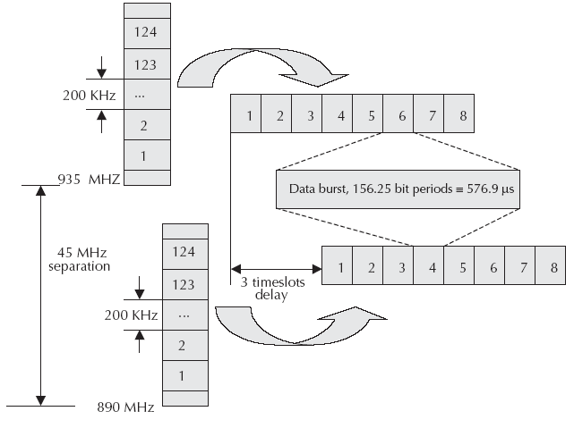
GSM Frequency Allocation
Carrier frequencies and TDMA frames

Slide 53
Authentication and Security
Authentication involves two functional entities - the SIM card in the mobile phone and the Authentication Center (AUC).
Following authentication by algorithm A3, a key is generated for encryption.
An algorithm A8 is used to generate the key while a different algorithm called A5 is used for both ciphering and deciphering procedures for signaling, voice and data.

Slide 54
A3 Algorithm
During authentication, MSC challenges the MS with a random number (RAND).
SIM card uses this RAND received from the MSC and a secret key Kj stored within the SIM as input. Both the RAND and the Kj secret are 128 bits long. Using the A3 algorithm with RAND and Kj as input a 32-bit output called signature response (SRES) is generated in the MS and then sent back to MSC.
Using the same set of algorithms, the AUC also generates a SRES. The SRES from MS and the SRES generated by the AUC are compared.
If they are the same, the MS is authenticated.

Slide 55
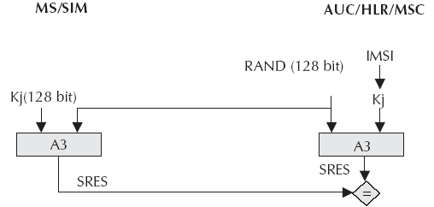
A3 Algorithm
The idea is that no keys will be transacted over the air. However, if the SRES values calculated independently by the SIM and the AUC are the same, then Kj has to be same and if Kj is same, SIM card is genuine.

Slide 56
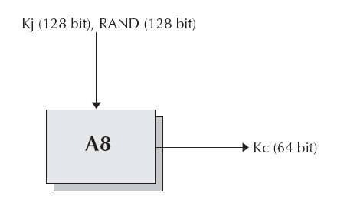
A8 Algorithm
A8 algorithm is the key generation algorithm.
A8 generates a session key, Kc, from the random challenge RAND (received from the MSC) and from the secret key Kj.
Keys are generated at both the MS and the network end. The session key, Kc, is used for ciphering till the MSC decides to authenticate the MS once again.

